Slide 1
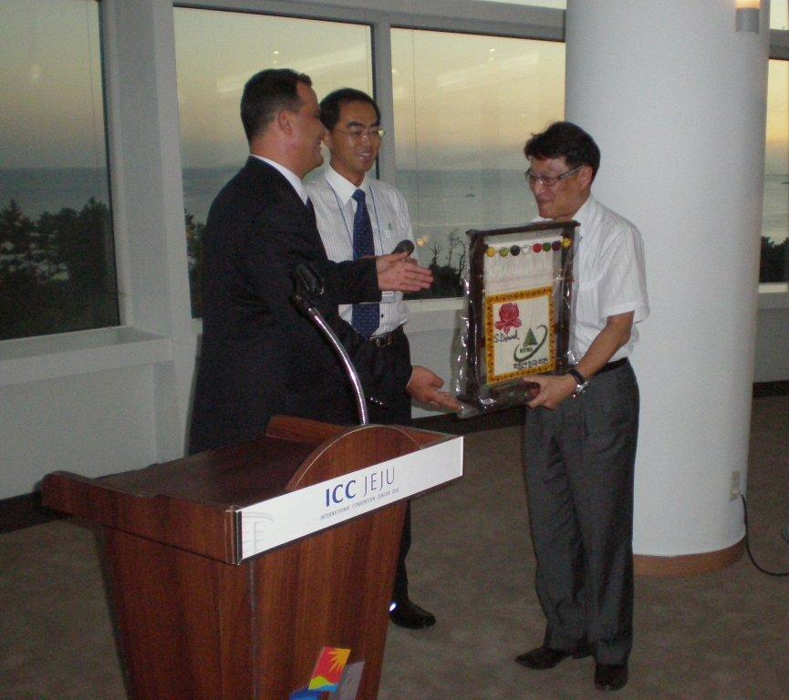
Seed orchards - introduction
Dag Lindgren 120522 Turkey

Slide 2
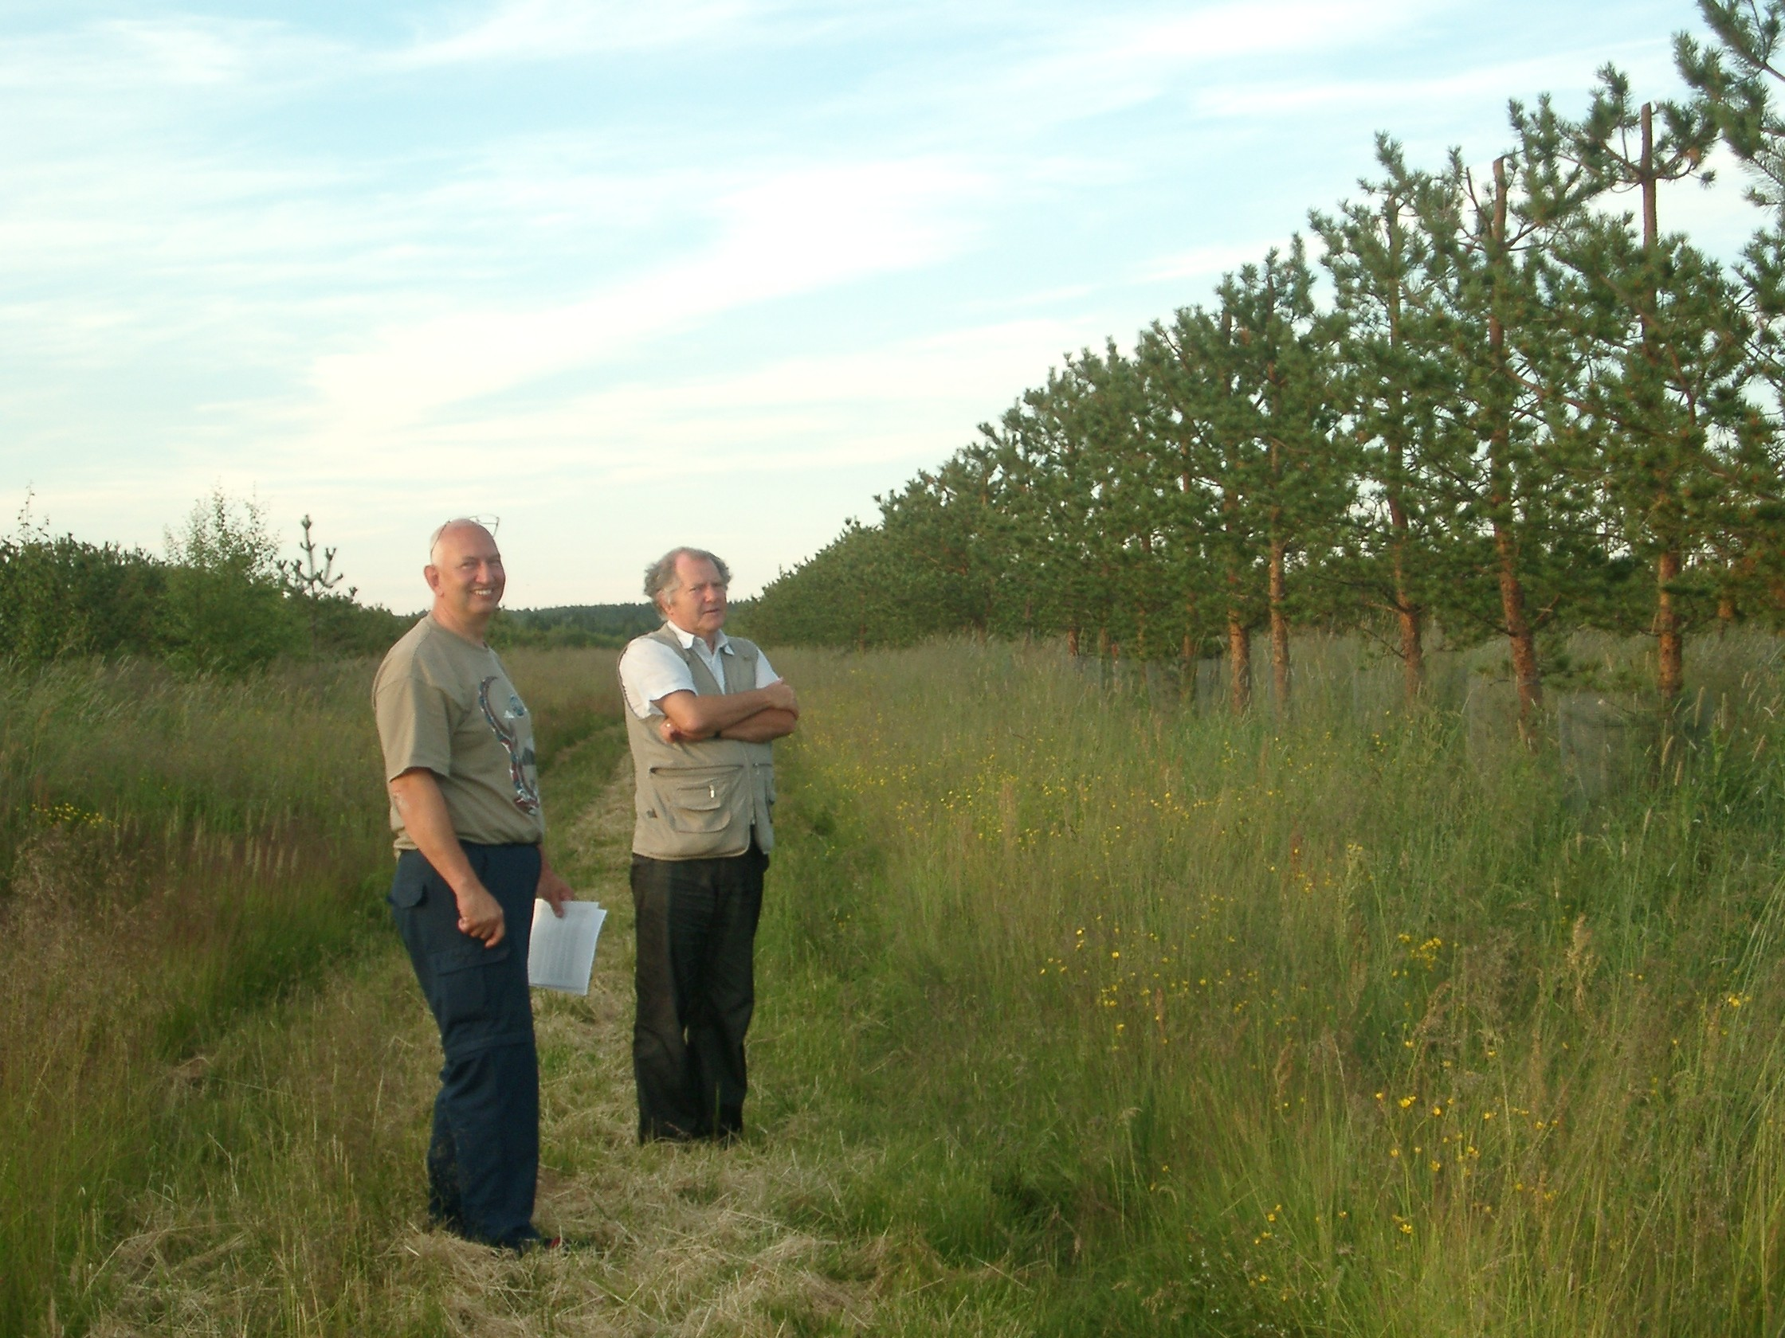
Seed orchards - the work horse!
Major seed orchard programs have existed since more than half a century
Seed orchards have not been phased out because of more modern technology
Most Swedish forest cultivations today use seed orchards. New seed orchards are established heading for 100 % supply by non-governmental financiation
New seed orchards with better material increase the gain threefold compared to initial phenotypic plus tree selection
Only percent of the current Swedish forest plantations are with clones
Photo Yuosry El-Kassaby

Slide 3
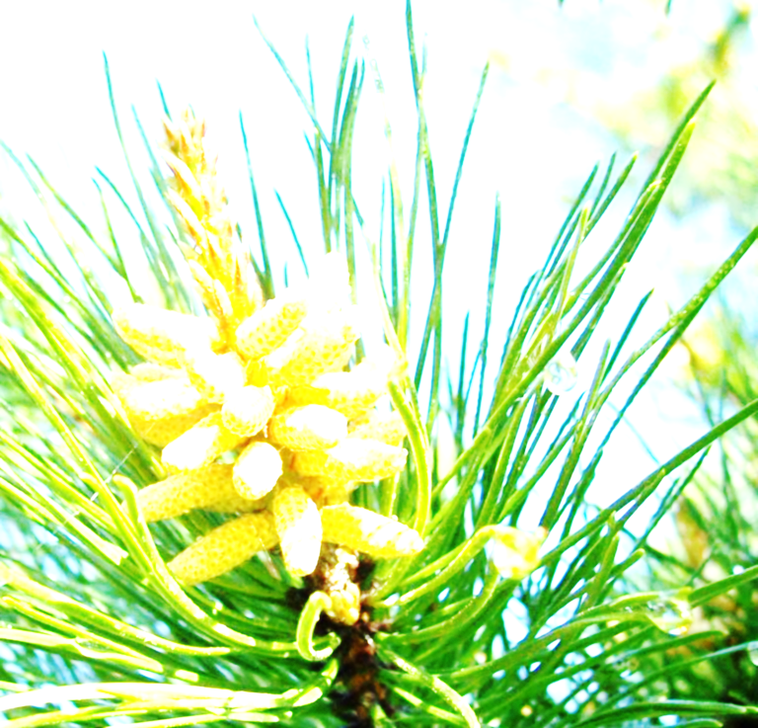
Long term breeding supports seed orchards
Seed orchards deploy progress of tree breeding into forests. Thus tree breeding and seed orchards interface and depend on each other. Generally seed orchards are the most used way of gain deployment. Seed orchards require efficient long term breeding!
Photo: Jan Kowalczyk

Slide 4
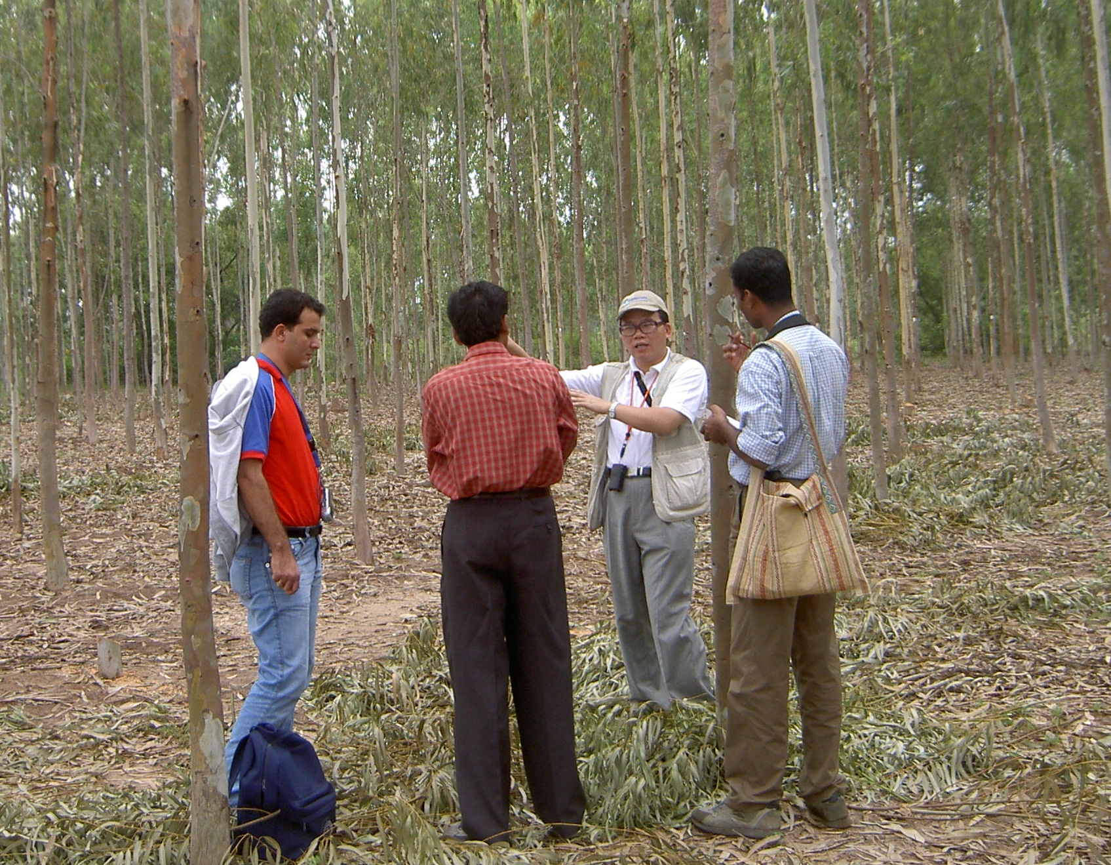
Seed orchards are sustainable and environmental
Forests create what we need from water, air and sunshine;
The water and air is recycled after use;
Seed orchards mean that we get more of what we need, while the factory is continuously improved;
Seed orchards can help in reforestation
Seed orchard forestry is more than just sustainable and renewable. When a tree is harvested it is replaced by a superior one.
Photo Dag Lindgren

Slide 5
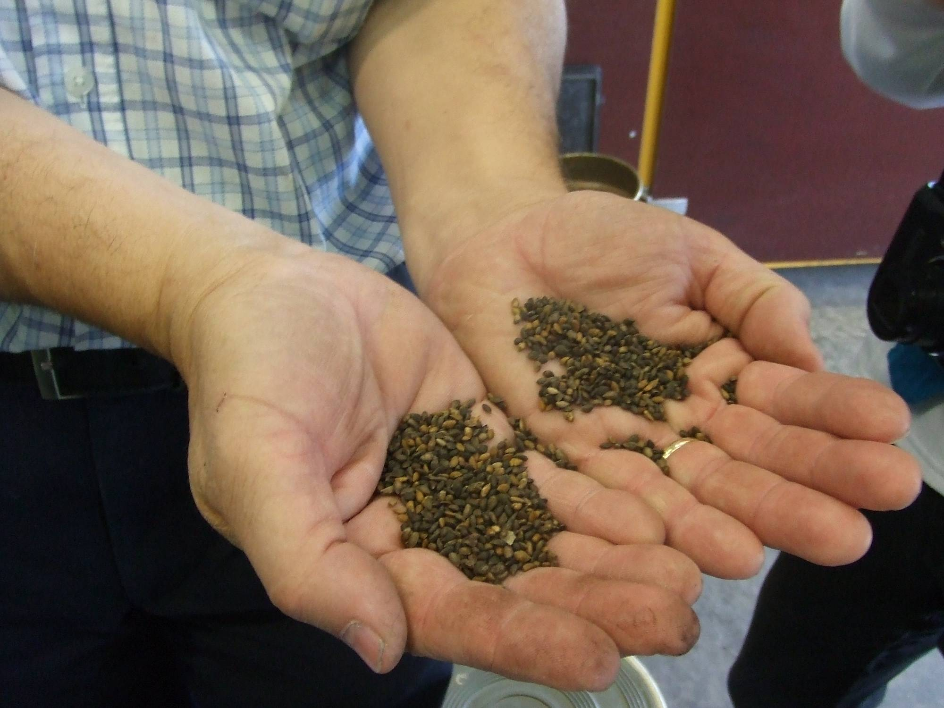
Seed orchards are the cradle of the future!
Seed orchards create the physical future for a considerable fraction of our countries
Seed orchards create resources
Seed orchards - our gift to those coming after us
Seed orchards are spearheads against the far future
Seed orchards are a symbol for belief in long time survival of Man.
A society, which does not build seed orchards, is unlikely to survive and not trustworthy
Photo Anders Fries

Slide 6
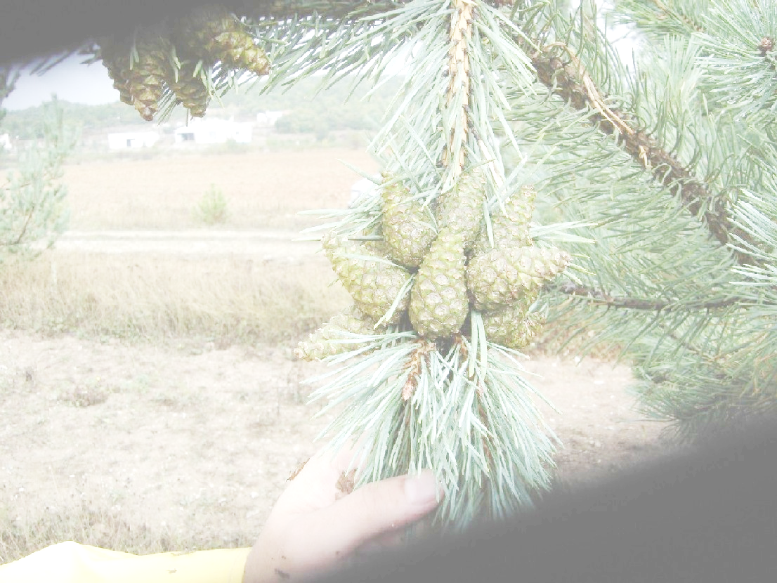
Seed orchards for an uncertain future..
Seed orchards are not a solution for sites, where planting or seeding is not seen as an option, but better seed orchards where suitable, allow more room for other land uses;
We become more people to share the Globe;
Many will probably demand more and get a better life;
Pollution accumulates and their global impact grows;
Fossil resources got more expensive and scarce;
Well functioning trees are usually environmentally beneficial;
Seed orchards are inexpensive compared to what they are predicted to do. They are the most cost-effective and least ecological doubtful road to improved forest production;
Seed orchards are predictable and flexible allowing changes in target area or modification of genetic output;
Do not abstain from seed orchards!!
Photo Nebi Bilir

Slide 7
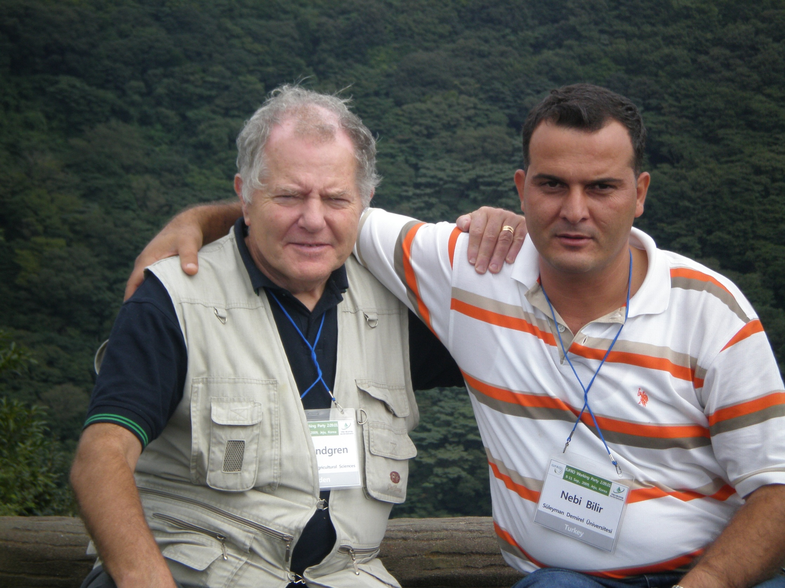
End

